Slide 1
PHYLUM -Platyhelminthes
Dr. Bindhusaran M.D. (Hom.)
Assistant Professor
Dept. of Pathology & Microbiology

Slide 2
Cestodes
Long segmented worms
Size few mm to several meters
Adult seen in intestine of man
Sexes are not separate
Alimentery canal is absent

Slide 3
TAENIA SOLIUM
pork tapeworm
Small intestine- upper jejeunum

Slide 4
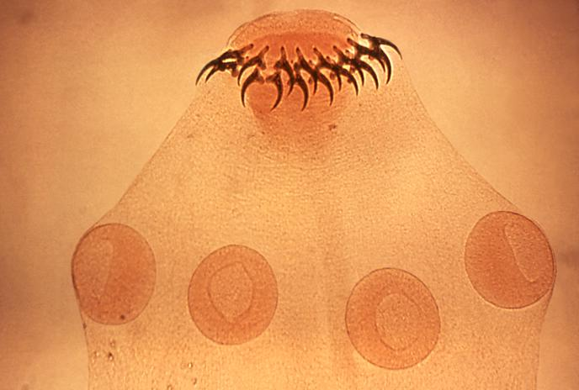
Morphology
ADULT WORM:
White , semitransparent 2-3 meters long
Parts:
Scolx( head)- pin head size, provided with rostellum which posses double row of hooklets

Slide 5
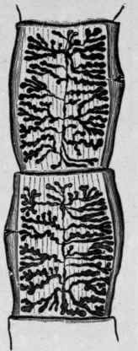
morphology
Neck - short
Proglottides ( segments): 800- 900 segments,
Immature, mature and gravid segments

Slide 9
segments
Gravid segment is 12mm X6mm size
Common genital pore at margin which alternate iregularly between margins
Gravid uterus consist a median longitudinal stem and 5 – 10 lateral branches
Gravid segments expelled in chains
Worm has life span of 25 years

Slide 10
eggs
Spherical and brown in color
Thin outer shellv
Inner embryophore is brown , radially striated
Contain an oncosphere with 3 pairs of hooklets
Remain viable for 8 weeks
Infects human and pig

Slide 11
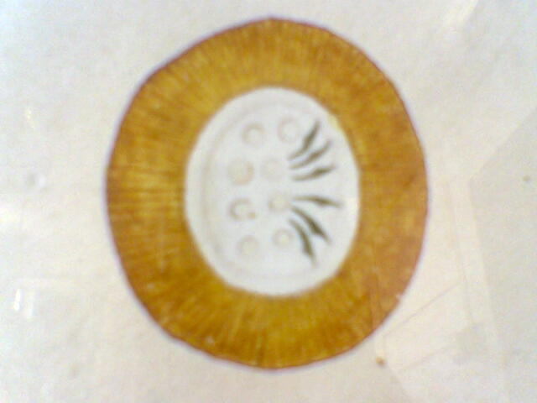

Slide 12
Life cycle
Two hosts
Man – definitive host
Pig – intermediate host

Slide 13
Life cycle in pigs
Adult worm in intestine
Gravid segments are expelled in stool
Segment disintegrate and eggs comes out
Eneter pig’s intestine through food
Oncoshere is liberated
Penetrate gut wall reaches mesenteric lymphatics and finally circulation
Reaches muscle of pig and develops into larva( cysticercus cellulosae)

Slide 15
Human cycle
Infected eating infected pork with cysticercus
On coming to contact with bile exvaginates and scolex attaches to gutwall and grow into adult worm
Attain sexual maturity in 2-3 months
Gravid segments are expelled

Slide 16
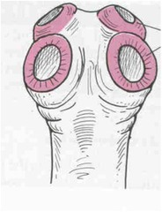
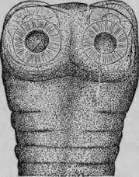
Taenia saginata
Beef tapeworm
Morphology :
ADULT WORM- semi transparent, white 5 – 10 metres length may grow upto 24 metre.
Head : 1-2 mm size, quadrate in outline, posses 4 suckers, there are no hooks or rostellum

Slide 17
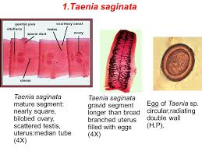
Taenia saginata morphology
Neck is long and fragile
Proglottids: 1000 to 2000

Slide 19
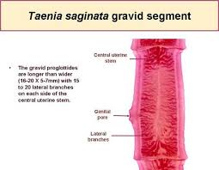
Gravid segemnt
2cm X 0.5 mm size.
Common genital pore is marginal
Gravid uterus consist central stem and 15 to 30 lateral branches
Gravid segments are expelled singly
Life span is 10 years

Slide 23
eggs
Spherical and brown in color
Thin outer shellv
Inner embryophore is brown , radially striated
Contain an oncosphere with 3 pairs of hooklets
Remain viable for 8 weeks
Infective only to cattle

Slide 24
Life cycle in cattles
Adult worm in human intestine
Gravid segments are expelled in stool
In the soil Segment disintegrate and eggs comes out
Eneter cattles intestine through food while grazing
Oncoshere is liberated in the intestine
Penetrate gut wall reaches mesenteric lymphatics and finally circulation
Reaches muscle of cattle and develops into larva( cysticercus bovis)

Slide 25
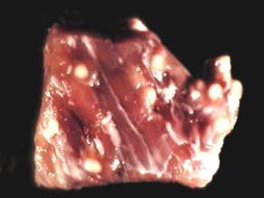
Human cycle
Infected eating infected beef with cysticercus (measly beef)
On coming to contact with bile exvaginates and scolex attaches to gutwall and grow into adult worm
Attain sexual maturity in 2-3 months
Gravid segments are expelled

Slide 27
Larval development of T. saginata and T.solium
Cysticercus bovis:
This is the larval stage developing in the muscles of cow or buffalo
Measures 5-10 mm breadth by 3 – 4 mm length
Conatin unarmed scolex
Can live for 8 month in the flesh of cattle
Can develop into adult worm when ingested by man

Slide 28
Cysticercus cellulosae
This is larval stage of T.solium developing in muscles of pig.
Mature cyst is opalescent ellipsoidal body and measures 8 to 10 mm width X 5 mm length
There is dense milky white spot at the side where the scolex with hooks remain invaginated( remain enclosed in a sheath)
Cyst contain fluid rich in salt and albuminous material
They can live for 8 months in pigs flesh and develops into worm when ingested by man
Cysticercus is found in man also

Slide 29
Pathogenesity
Adult worm usually do not produce symptoms
Occasionally vague abdominal discomfort, anaemia, chronic indigestion, diarrhea alternate constipation etc.
Larva
Causes Cysticercosis

Slide 30
Cysticercosis
It is the development of larval stage of taenia solium the human body
by drinking contaminated water or by eating uncooked vegetables with taenia solium egg
Cysticercus cellulosae develops in human body
Clinical features depends upon the location of the cysticerci in the body

Slide 31
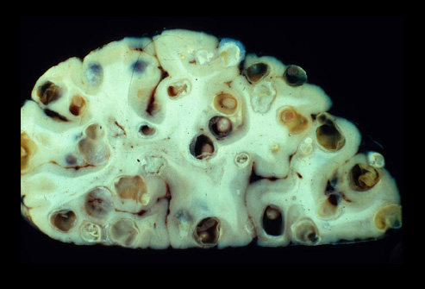
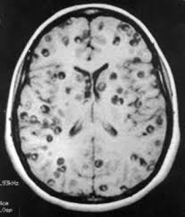
Types of cysticercosis
Neurocysticercosis :
Development of cysticercus cellulosae in the brain
Manifested by epileptic attack
Diagnosed by ELISA test, CT or MRI scan of brain.

Slide 32
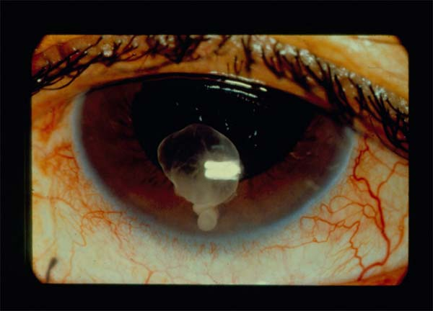
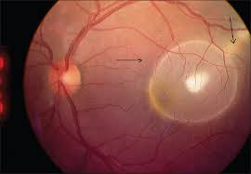
Ophthalmic cysticercosis
Development of cysticercus cellulosae in the eyes
Diagnosed by fundoscopy

Slide 33
Cutaneous cysticercosis
Manifested by subcutaneous nodules at different parts of body

Slide 34
DIAGNOSIS OF TAPEWROM
STOOL EXAMINATION:
Naked eye examination of stool – presence of segements which should microscopically examined for the structure of uterus
Microscopic examination of stool
For detection of eggs
Perianal swab ( NIH swab) for presence of egg

Slide 36
DIAGNOSIS OF CYSTICERCI
Biopsy of subcutaneous nodule contain cysticerci
X – ray examination of skull and soft tissues
CT scan of brain and affected organs
MRI of brain
Myelography to detect spinal cysticerci
Eosinophilia
Antigen can be detected in serum and CSF and ELISA

